Slide 1

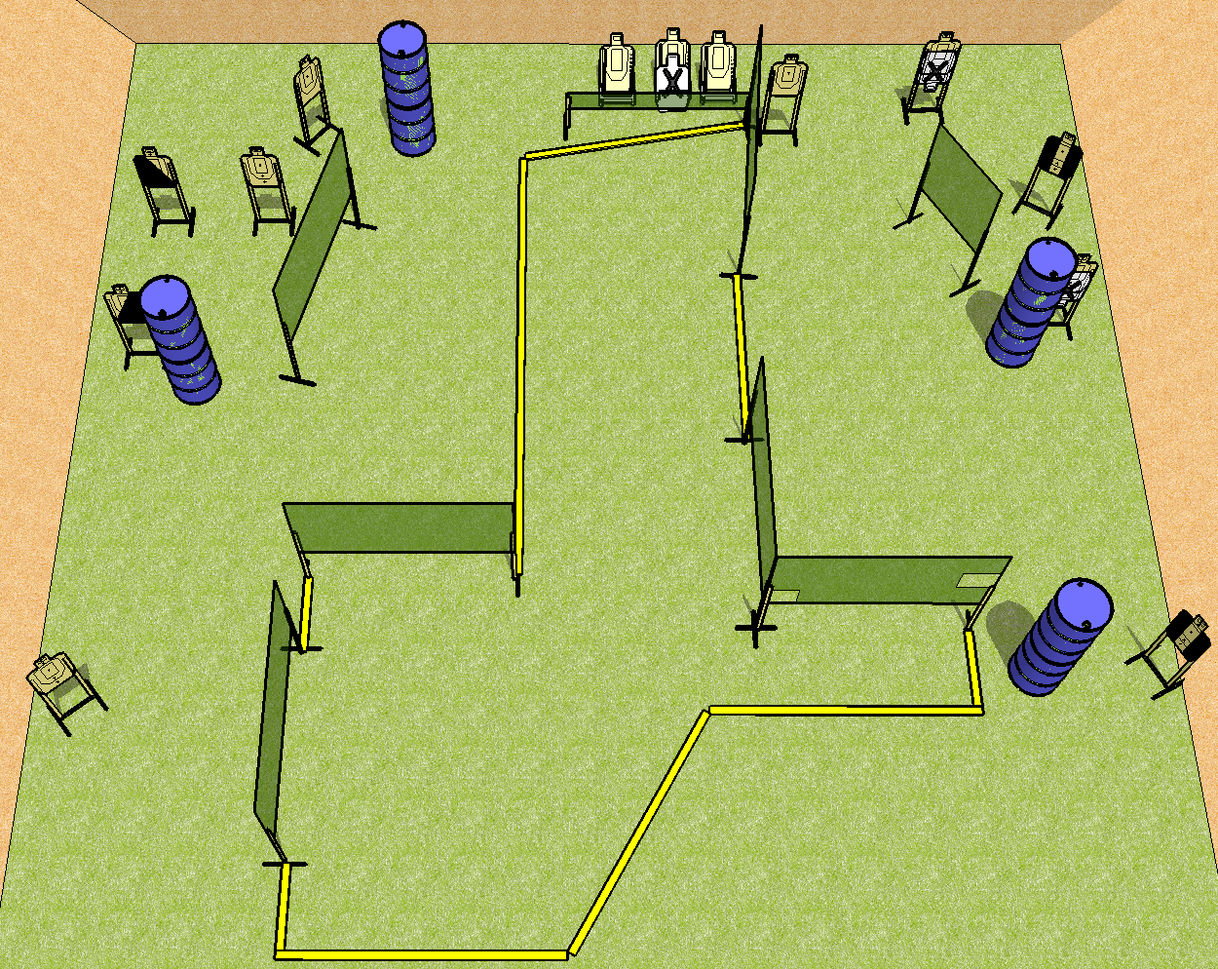
 | Dothan Practical Shooters – USPSA Match Cul-De-Sac Course Designer : Drew Coleman Bay: B1
Round Count 26 rounds 13 USPSA
Equipment List 14 wall feet Low wall 2 tux, 1 left + 1 right diag 12 targets (9 + 3 NS)

Slide 2
Cul-De-Sac
Written Stage Briefing
Scoring: Comstock Rounds: 26
Targets: 13 USPSA
Handgun start position: anywhere completely outside the shooting area, wrists below belt. Handgun is loaded and holstered.
PCC start position: anywhere completely outside the shooting area, stock on belt. Loaded carbine is held with both hands, safety on.
Stage Procedure: on the audible start signal, engage targets as they become available from within the shooting area.

